Slide 1
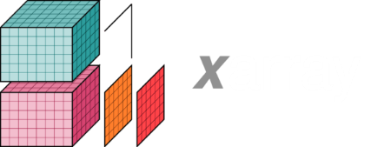
Dask & xarray Demo
Chris Xiao
June 2021

Slide 2
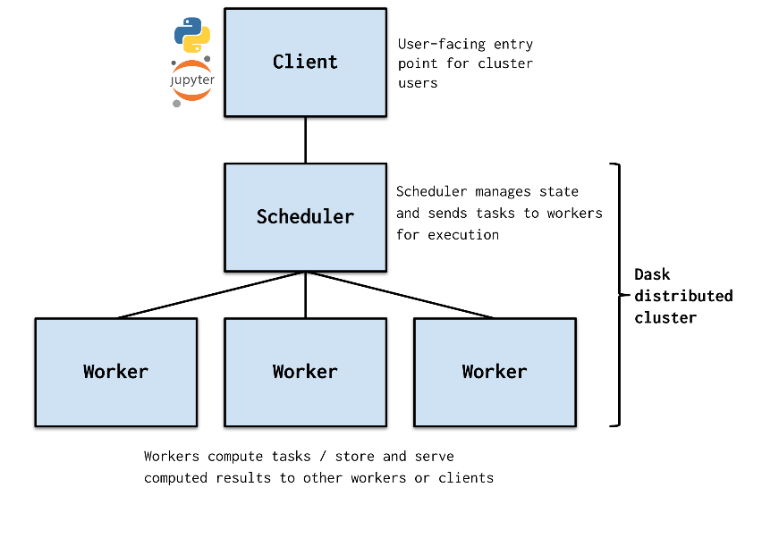
Dask
Parallel computing in Python
Wraps familiar tools
numpy, pandas, xarray, …
Scalable
https://docs.mlrun.org/en/latest/runtimes/dask-overview.html

Slide 3
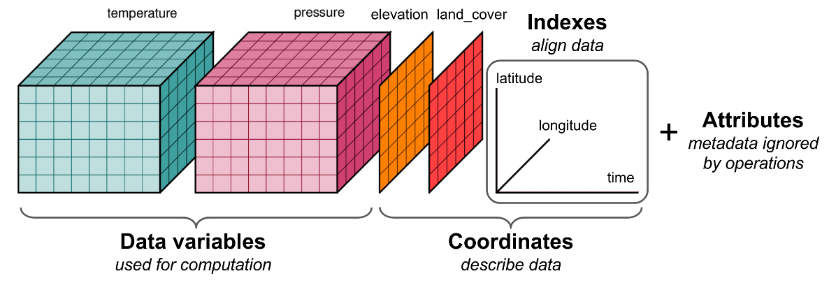
xarray
N-dimensional labeled arrays in Python
Tailored to netCDF
Intagrates with Dask
https://matthewrocklin.com/slides/ams-2018.html#/2

Slide 4
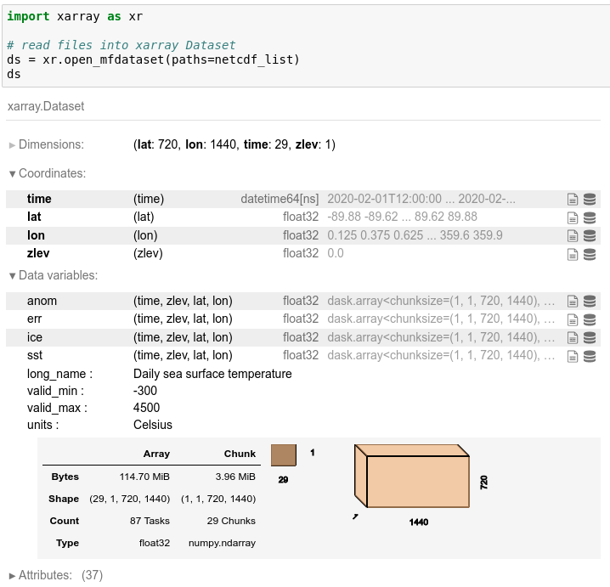
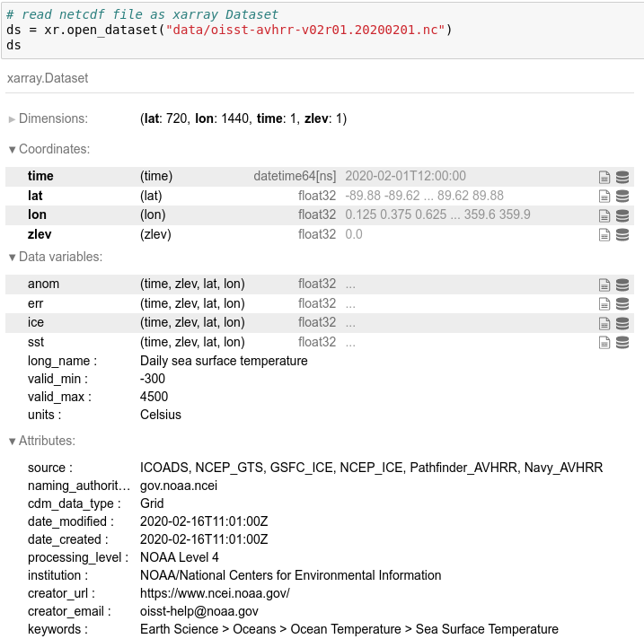
Working with netCDF

Slide 5
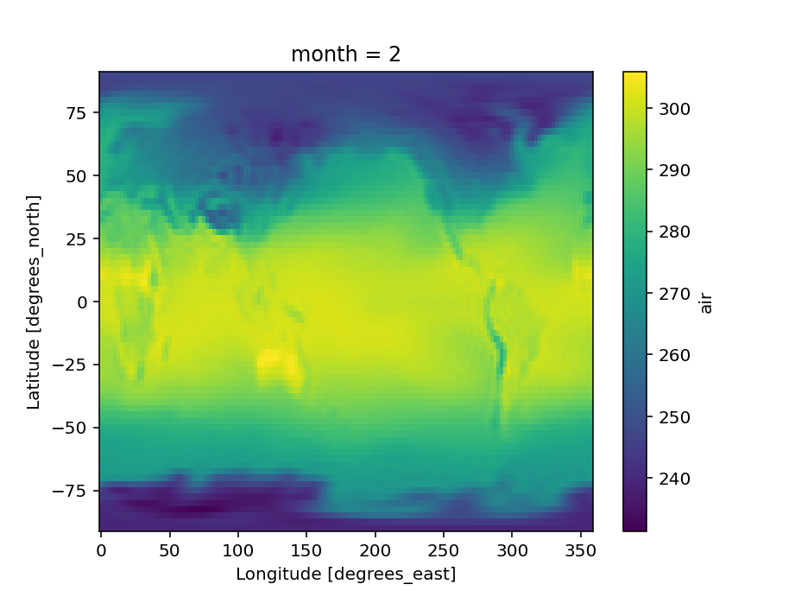
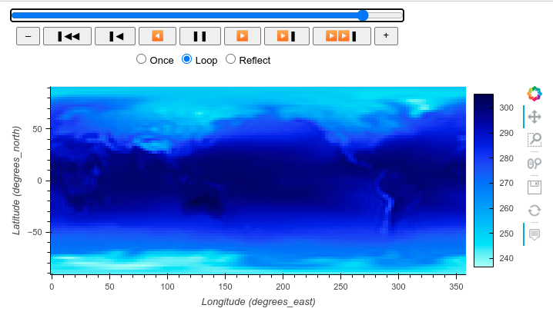
Plotting

Slide 6
Deployment
Local Cluster
HPC
Kubernetes
Dask Gateway / DaskHub for multi-user

Slide 7
Demo

